Slide 1

Project Title – Netflix Dataset Analysis
[Haarthi Vallabhaneni ]
[STU657da33295f551702732594]

Slide 2

PROBLEM STATEMENT
Netflix has become one of the most prominent global streaming platforms, continuously expanding its library with a mix of original productions and licensed content. However, with growing competition from platforms like Amazon Prime, Disney+, and regional OTT providers, Netflix must strategically analyze its content catalog to identify strengths, gaps, and opportunities.
The specific problem to be addressed in this project is 'Content Trends Analysis for Strategic Recommendations'. The aim is to uncover how Netflix’s content distribution (Movies vs. TV Shows, genres, and country contributions) has evolved over the years. This will enable the identification of key genres, audience preferences, and strategic insights into global content expansion.

Slide 3
Project Description
The Netflix Dataset Analysis – Content Trends and Strategic Recommendations project focuses on understanding how Netflix’s content has evolved over time in terms of Movies vs. TV Shows, genres, and country contributions. The dataset contains 7,789 records and 11 columns, with key details such as title, director, cast, country, release date, rating, duration, and type (movie or TV show). The data spans from 2008 to 2021, covering a wide range of genres and countries.
This project aims to explore Netflix’s content distribution patterns, uncover trends over time, and highlight areas that can inform strategic business decisions. The analysis helps answer questions such as:
How has the proportion of Movies and TV Shows changed over the years?
Which genres and countries contribute the most content?
What are the dominant audience preferences globally?
By studying these content trends, the project provides data-driven insights that can guide Netflix in content acquisition, production, and global expansion strategies. Understanding these trends is essential for ensuring that Netflix continues to cater to diverse international audiences and maintains its leadership in the OTT industry.

Slide 4

WHO ARE THE END USERS?
Netflix Content Strategists – To identify popular genres and plan
future content development.
Business & Marketing Teams – To understand audience preferences across
regions and create targeted campaigns.
Data Analysts and Researchers – To study streaming trends, audience behavior,
and global content evolution.
Students and Academics – To learn data analysis, visualization, and real-world
application in the media industry.
Media and Entertainment Companies – To analyze Netflix’s strategy and gain
insights for their own content planning.

Slide 5

Technology Used
Python - Core programming language
Pandas & NumPy - Data cleaning and preprocessing
Matplotlib/Seaborn- Data visualization and feature importance
Google Colab - Cloud-based environment for running the project File handling libraries
openpyxl (for Excel) and built-in CSV handling

Slide 6
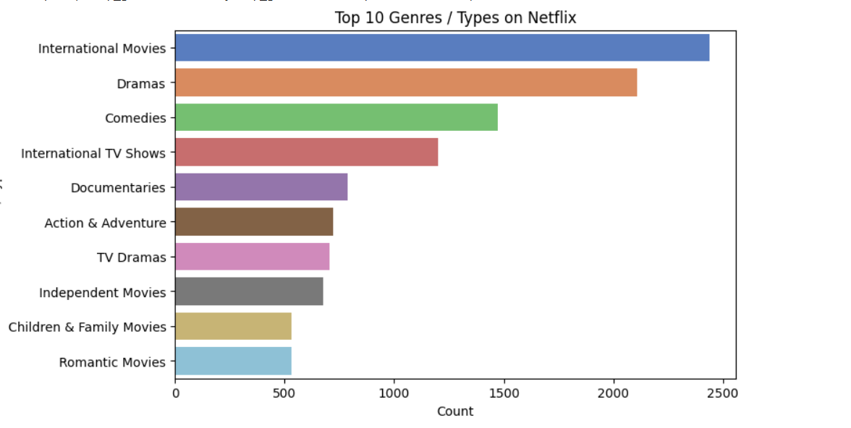
RESULTS1

Slide 7
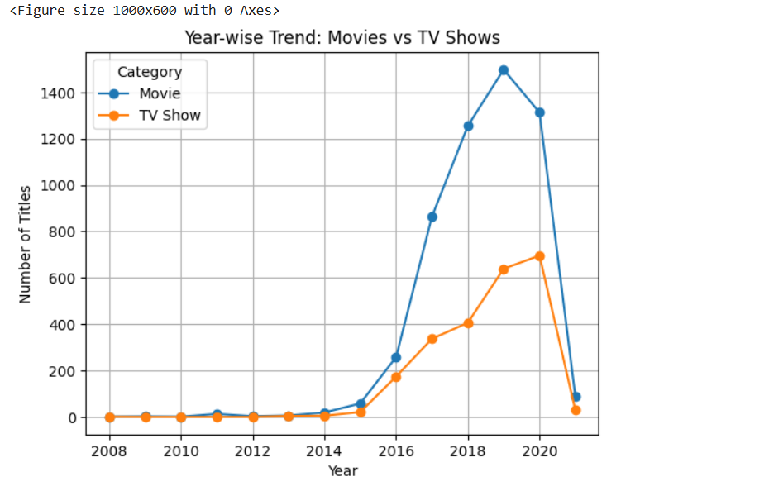
RESULTS2

Slide 8
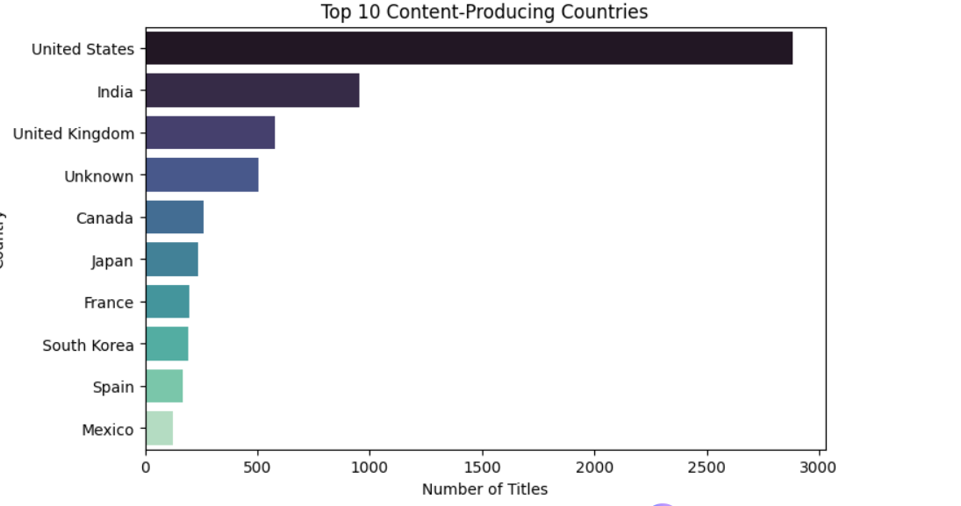
RESULTS3

Slide 9
GitHub repository
HaarthiV13/VOIS_AICTE_Oct2025_NetflixDatasetAnalysis_VallabhaneniHaarthi

Slide 10

Getting started with Basics of Python Certificate

Slide 11

Data Visualization Certificate

Slide 12
Thank you
.
.

